Slide 1


ASSIGNMENT 5
Wireless System Capacity
& Fading Simulation

Slide 2
Problem Statement
In modern wireless communications, signal quality fluctuates due to environmental factors. The core challenge is to accurately model:
•
Path Loss & Shadowing: Signal degradation over distance.
•
Multipath Fading: Rapid fluctuations (Rayleigh fading) affecting signal strength.
•
Capacity Estimation: Calculating the maximum data rate (Shannon Capacity) under these varying conditions.

Slide 3




Objectives
User Deployment
Link Budget
Performance Analysis
Simulate a circular field with randomly distributed users relative to a Base Station.
Compute Path Loss, Received Power (dBm), and SNR considering shadowing.
Compare Shannon Capacity between an Ideal Channel and a Rayleigh Fading Channel.

Slide 4
System Parameters
Parameter | Value | Description
Frequency (fc) | 2 GHz | Carrier Frequency
Bandwidth (BW) | 10 MHz | Channel Bandwidth
Transmit Power (Pt) | 46 dBm | Base Station Power
Antenna Gains | Gt: 15dB, Gr: 0dB | Transmitter/Receiver Gains
Environment | alpha: 3.5, σ: 8dB | Path Loss Exp & Shadowing
Noise Temp (T0) | 290 K | Standard Temperature

Slide 5






Data Flow Diagram (DFD)
(Polar Coordinates)
(Capacity Calc)
(Freq, Power, Users)
(Plots & Tables)
(Path Loss + Shadowing)
(Dynamic SNR Calc)

Slide 6

Module 1: User Deployment
R = 200; N = 10;
FOR i = 1 to N:
angle = random(0, 2*pi)
radius = R * sqrt(random(0, 1))
% Polar to Cartesian
x = radius * cos(angle)
y = radius * sin(angle)
% Distance from Base Station (0,0)
d[i] = sqrt(x^2 + y^2)
END FOR
Logic:
•
Define a circular coverage area with radius R = 200m.
•
Generate N=10 users at random angles and radial distances.
% Polar to Cartesian
% Distance from Base Station (0,0)
END FOR
•
Convert Polar coordinates to Cartesian for plotting.
•
Calculate Euclidean distance d for Path Loss.

Slide 7
Module 2: Link Budget & Capacity
% Channel Model Function
FUNCTION Calc_LinkBudget(Pt, d):
% Log-Distance Path Loss + Shadowing
PL = PL_0 + 10*alpha*log10(d) + Random(sigma)
% Received Power (dBm)
Pr_dBm = Pt_dBm + Gt + Gr - PL
Pr_Watt = 10^((Pr_dBm-30)/10)
% Noise Power
Noise = k * Temp * Bandwidth
% Signal to Noise Ratio
SNR = Pr_Watt / Noise
RETURN SNR
END FUNCTION
Key Formulas:
•
Path Loss includes a random shadowing component sigma
•
Thermal Noise is derived from Boltzmann constant and Temperature.
% Log-Distance Path Loss + Shadowing
% Received Power (dBm)
% Noise Power
% Signal to Noise Ratio
RETURN
END FUNCTION
•
Shannon Capacity:
C = BW × log 2 ( 1 + SNR )

Slide 8

Module 3: Rayleigh Fading
% Fading Simulation
FOR EACH user:
% Generate Complex Gaussian Coefficient
h_real = randn()
h_imag = randn()
h = (h_real + j*h_imag) / sqrt(2)
% Fading Channel Power
Fading_Gain = abs(h)^2
% Modified SNR
SNR_Rayleigh = SNR_Static * Fading_Gain
% Calculate New Capacity
Cap_Rayleigh = BW * log2(1 + SNR_Rayleigh)
END FOR
Logic:
•
Simulate multipath effects using a complex Gaussian random variable h.
•
The envelope |h| follows a Rayleigh distribution.
% Fading Channel Power
% Modified SNR
% Calculate New Capacity
END FOR
•
The fading power modifies the static SNR.
•
This results in a "fluctuating" capacity compared to the static model.

Slide 9
Process Workflow

Slide 10
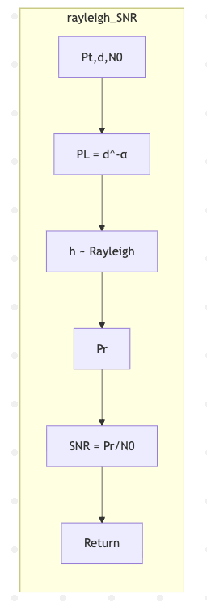
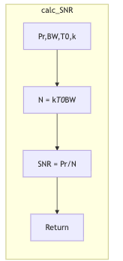

Slide 11






Results & Analysis
Path Loss
SNR Levels
Capacity Drop
Ranged between 104 dB to 131 dB. Highly dependent on the random shadowing factor ($\sigma = 8dB$) and distance.
Linear SNR varied drastically ($~0.2$ to $~10$). Users closer to the Base Station did not always have the best SNR due to shadowing.
Rayleigh fading introduced randomness. In some instances, fading increased capacity (constructive), but mostly caused fluctuations.
"Coherence time ($T_c$) was calculated around ~2ms to ~22ms depending on user velocity (1-25 m/s)."

Slide 12
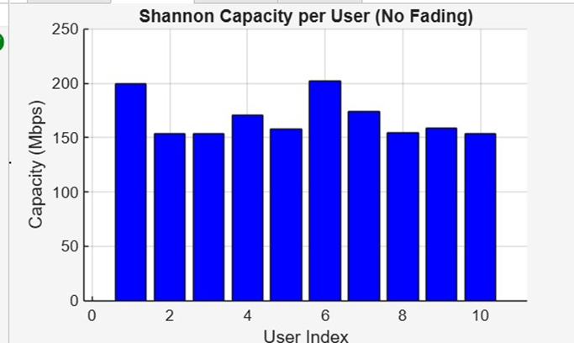
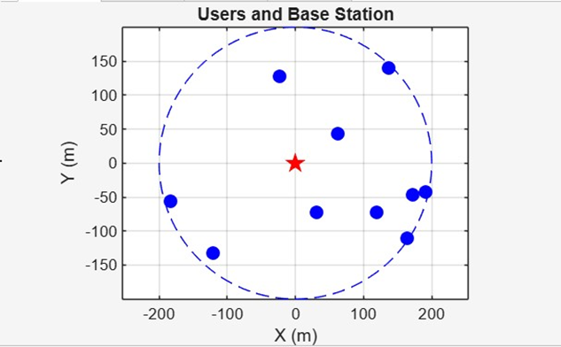
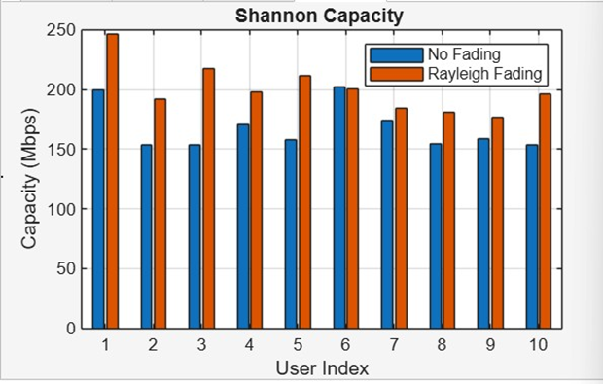
RESULTS

